Slide 1



Slide 2

Introduction & Guidelines
Launching Online Class Attendance Automation system
Welcome! Thank you for attending this session.
This session is delivered by Mr. Islam Alhasan with the support of IT Support Engineers.
This session will be recorded, and then it will be shared with all of the concerned members.
If you have any questions, please type them in the Q&A box and we will respond to you.
By the end of the week, you will be receiving an email with the session summary and recording.

Slide 3
Outline
Introduction to AU Connect
Zoom Attendance
Physical Attendance
Navigation
AU News
Q&A Session

Slide 4

AU Connect
The aim of this project is to help the university automate the process of taking the attendance for online and physical classes.
Also to allow the students and doctors to be able to navigate through the university easily.

Slide 5
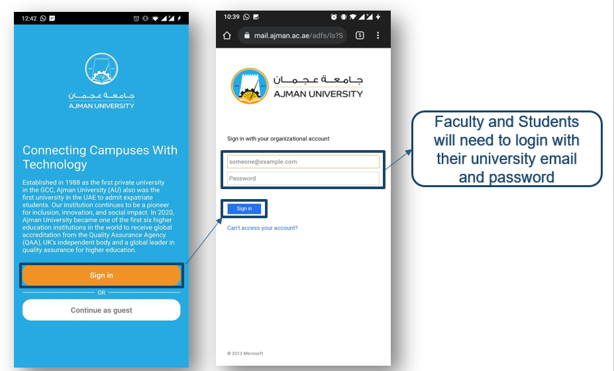
Zoom Attendance

Slide 6
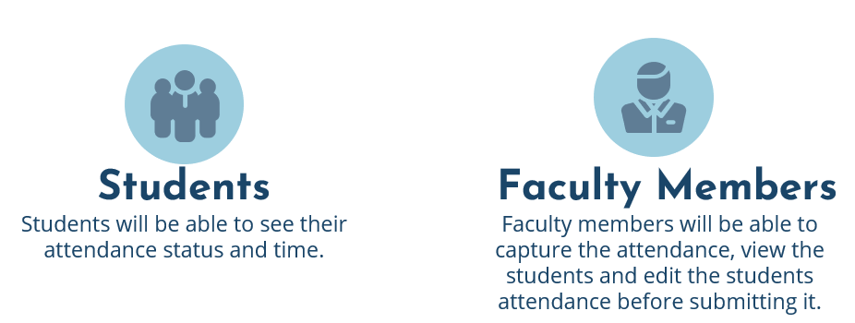

Slide 7
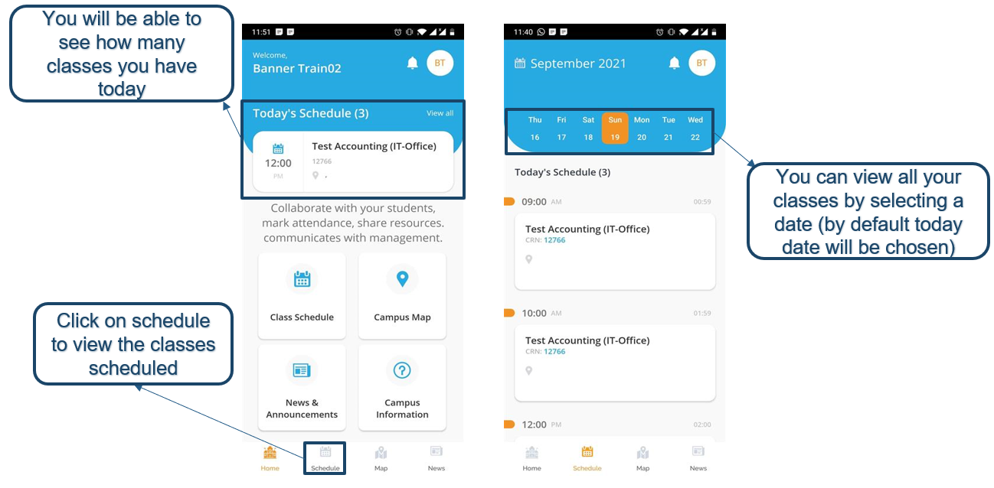
Zoom Attendance (Faculty Members)

Slide 8
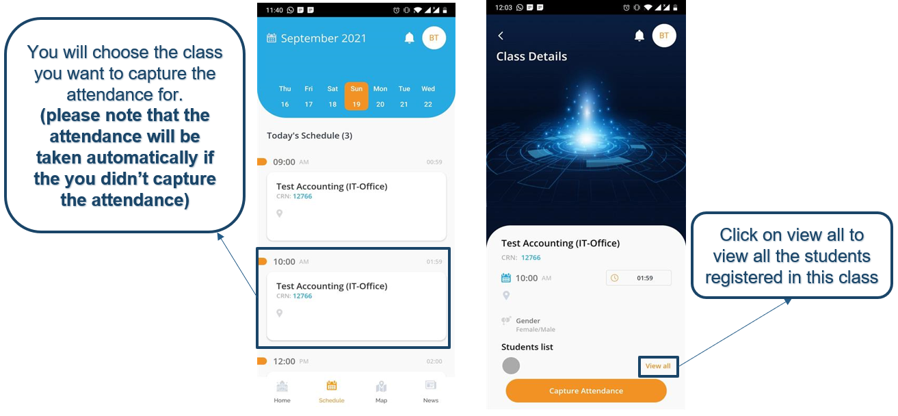

Slide 9
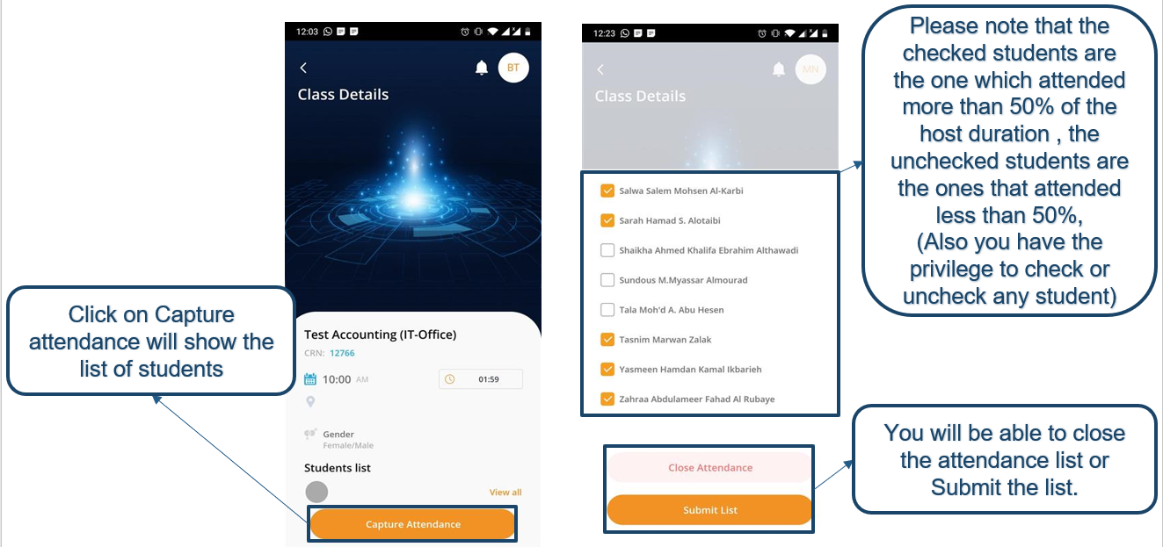

Slide 10
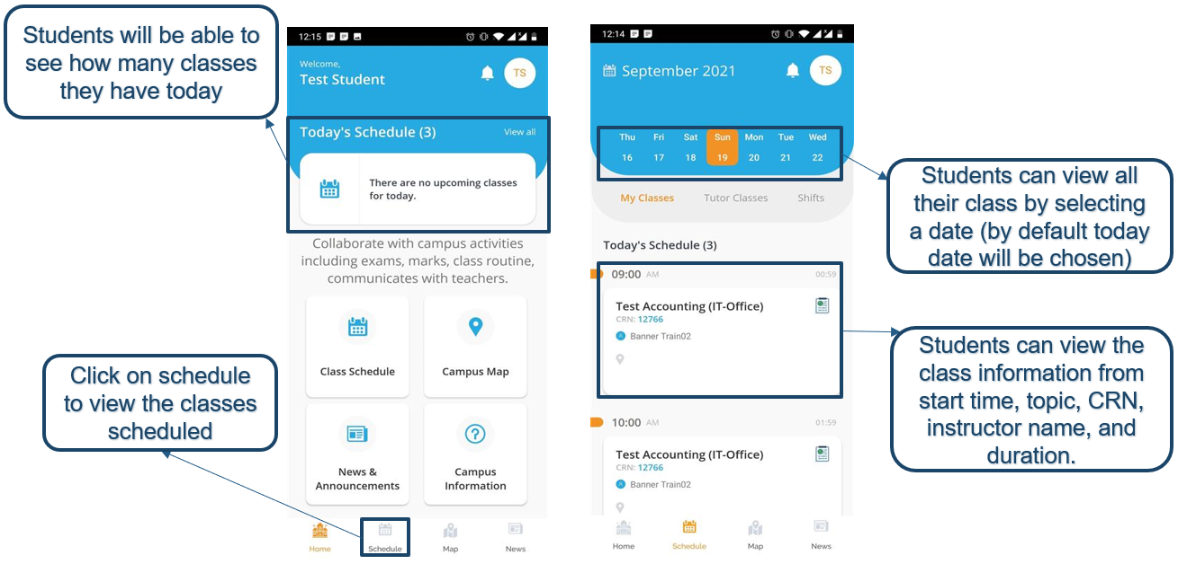
Zoom Attendance (Students)

Slide 11
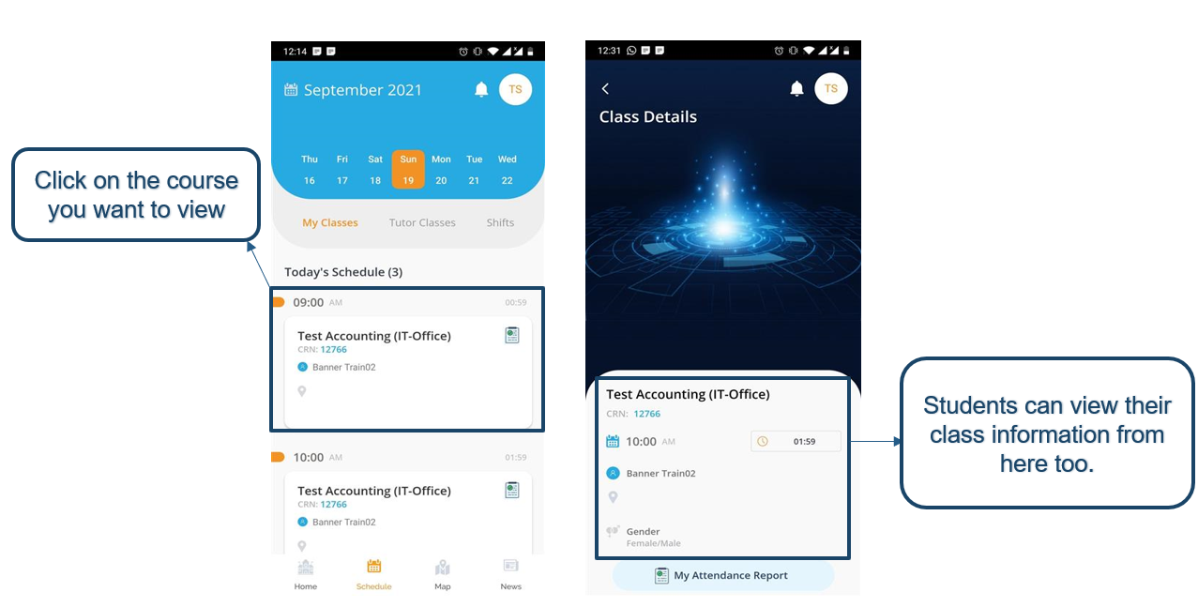

Slide 12
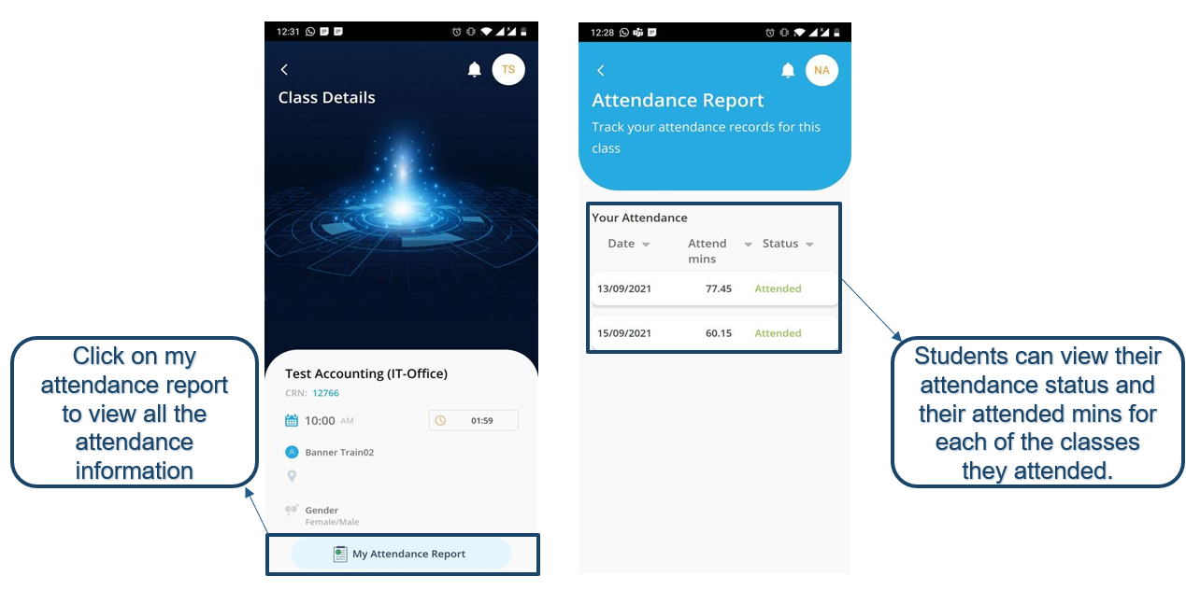

Slide 13
Physical Attendance

Slide 14
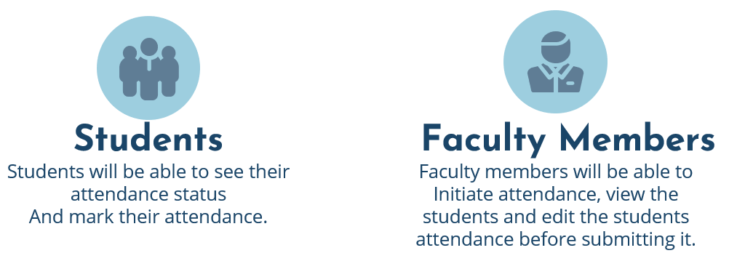

Slide 15
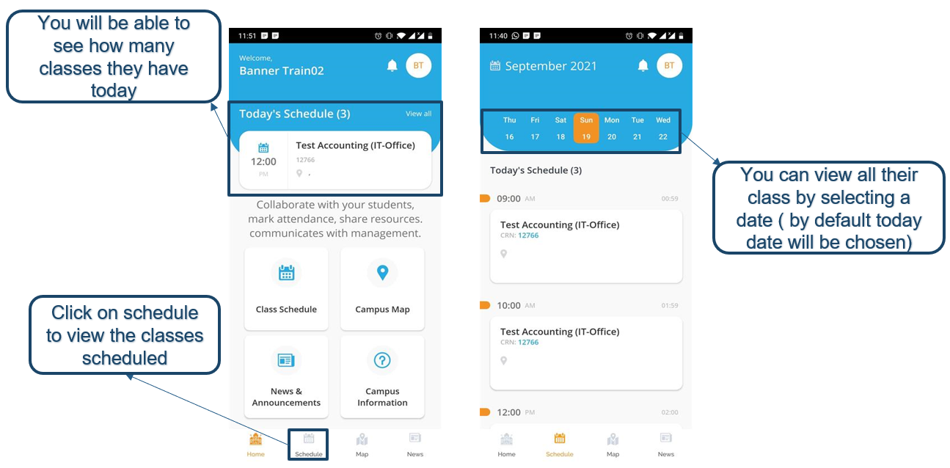
Physical Attendance (Faculty Members)

Slide 16
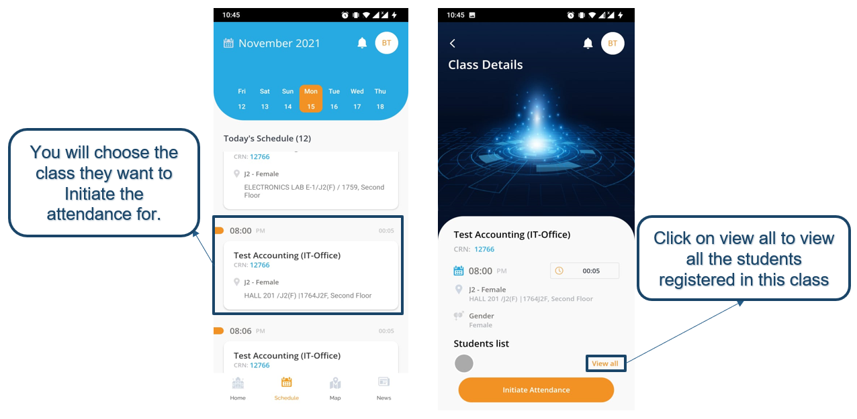

Slide 17
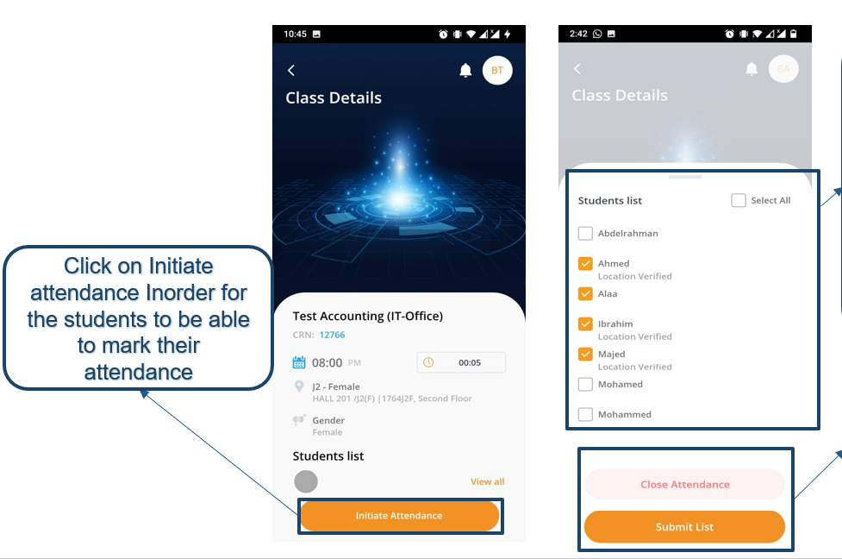
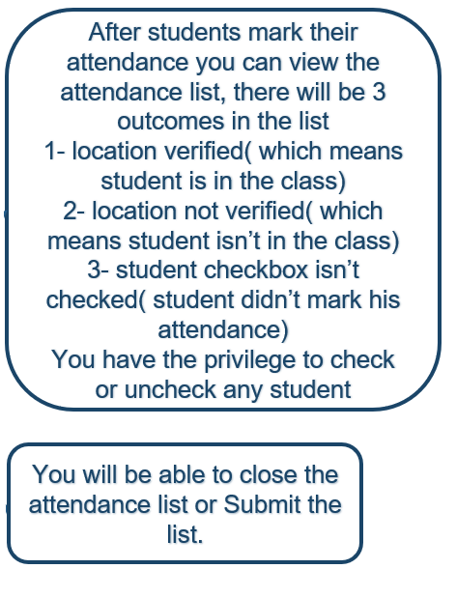

Slide 18
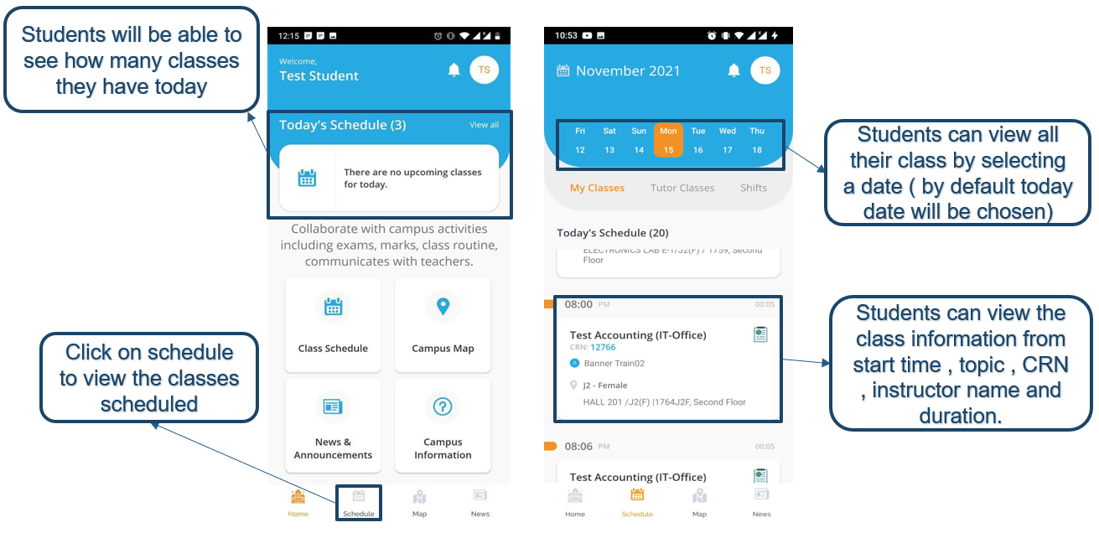
Physical Attendance (Students)

Slide 19
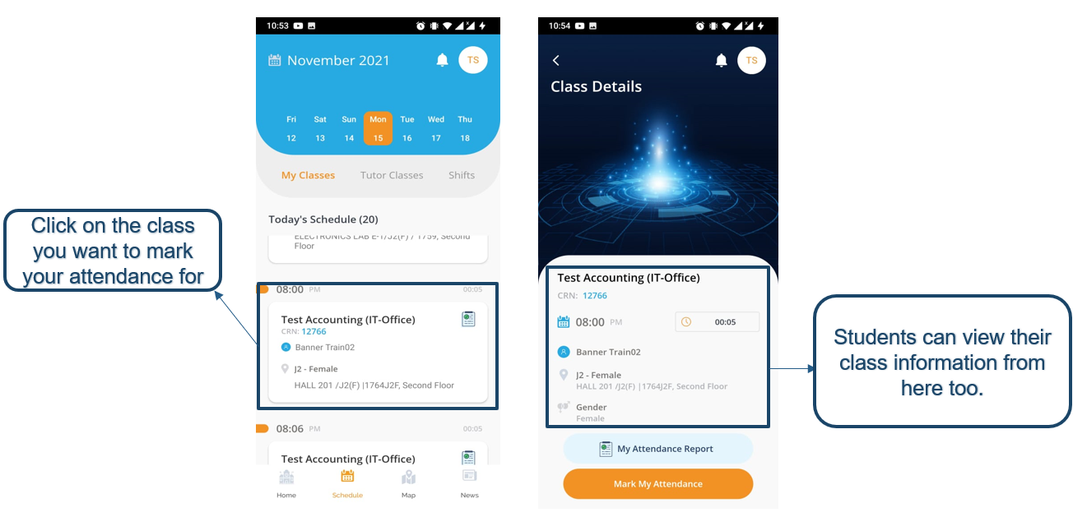

Slide 20
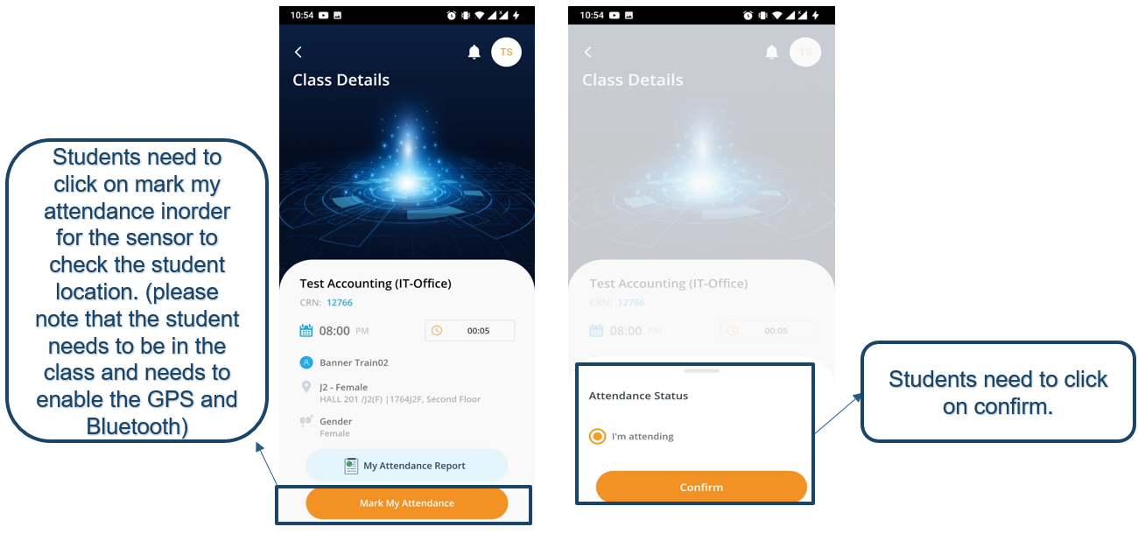

Slide 21
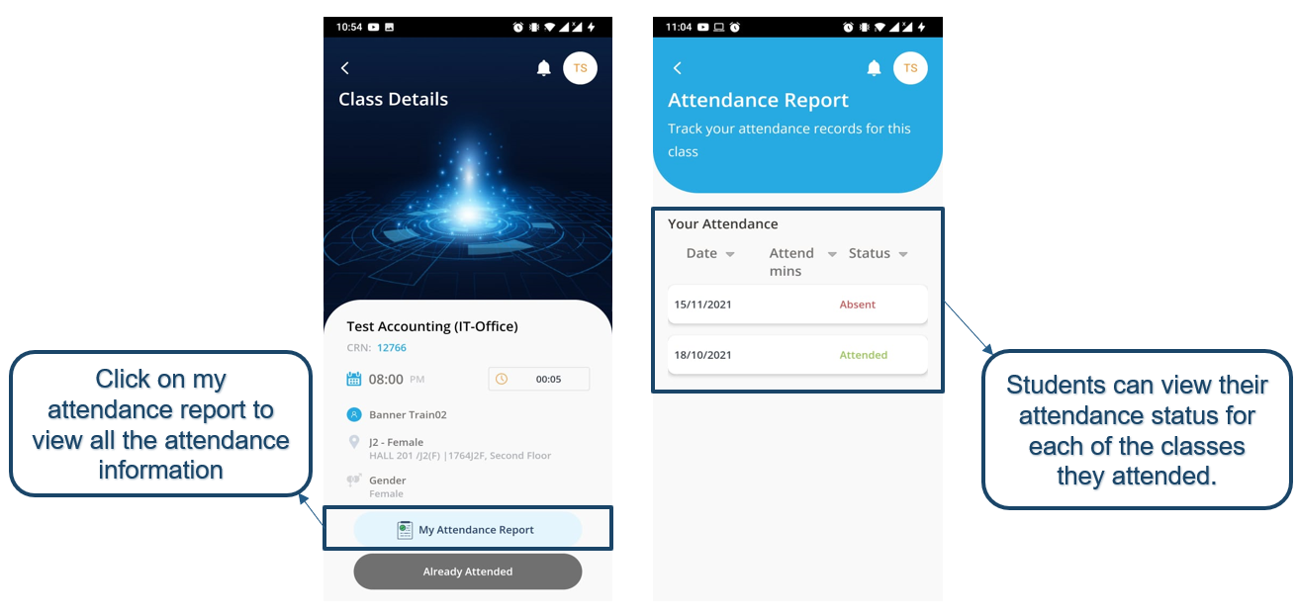

Slide 22
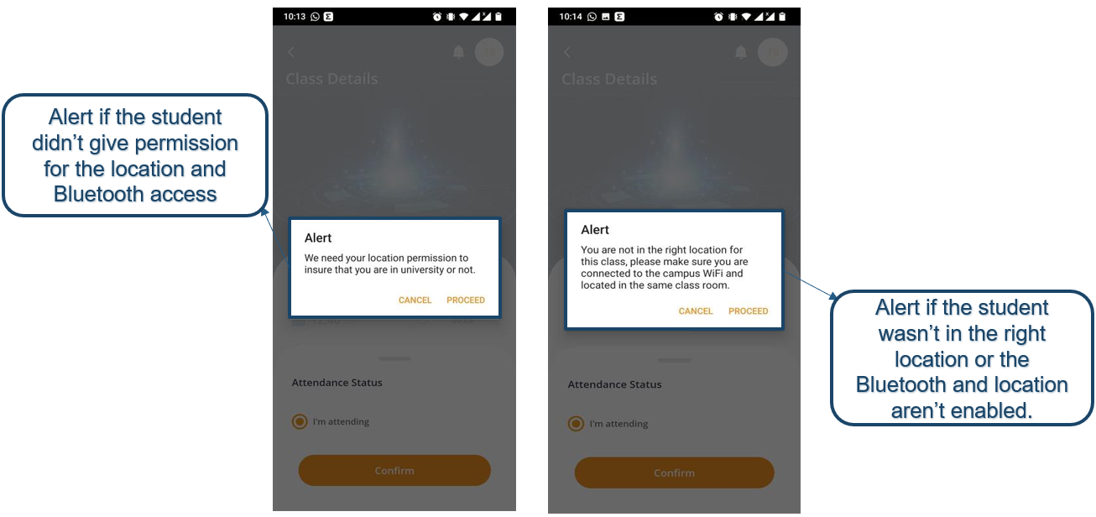

Slide 23
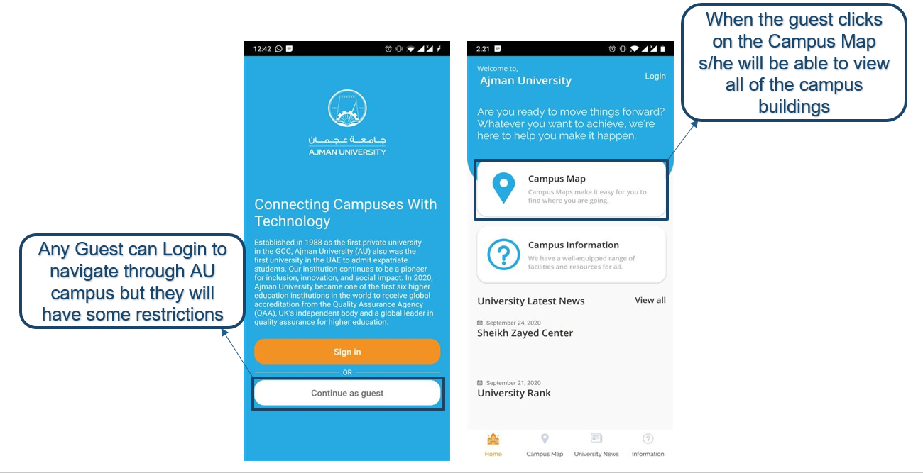
Guest Navigation

Slide 24
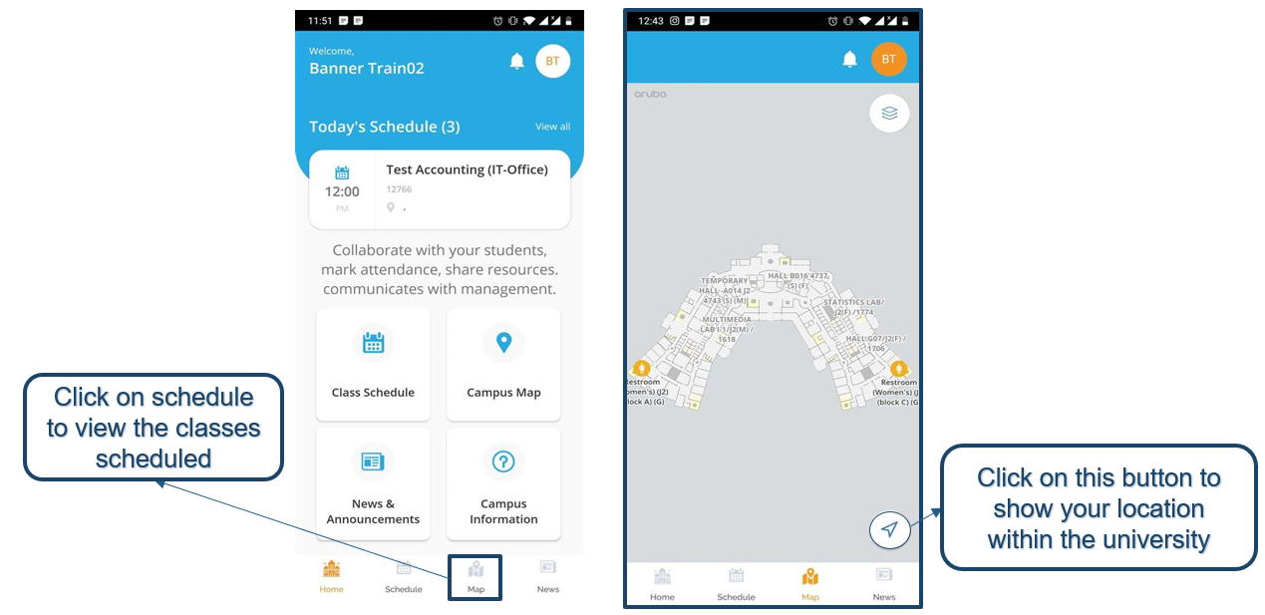
User Navigation

Slide 25
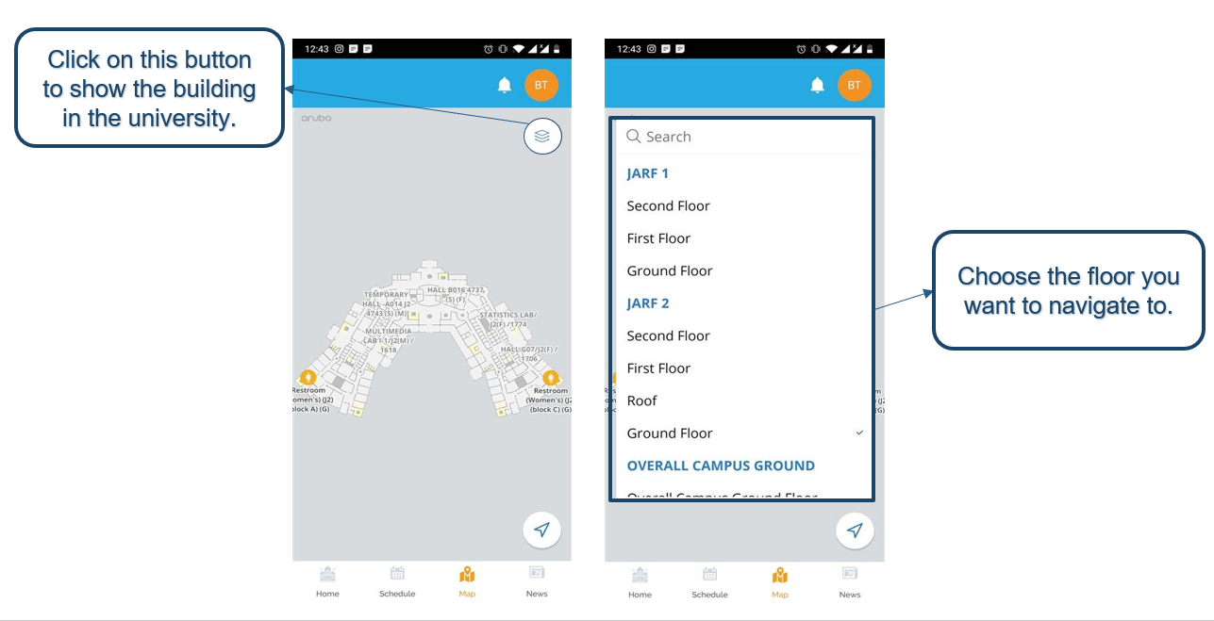
User & Guest Navigation

Slide 26
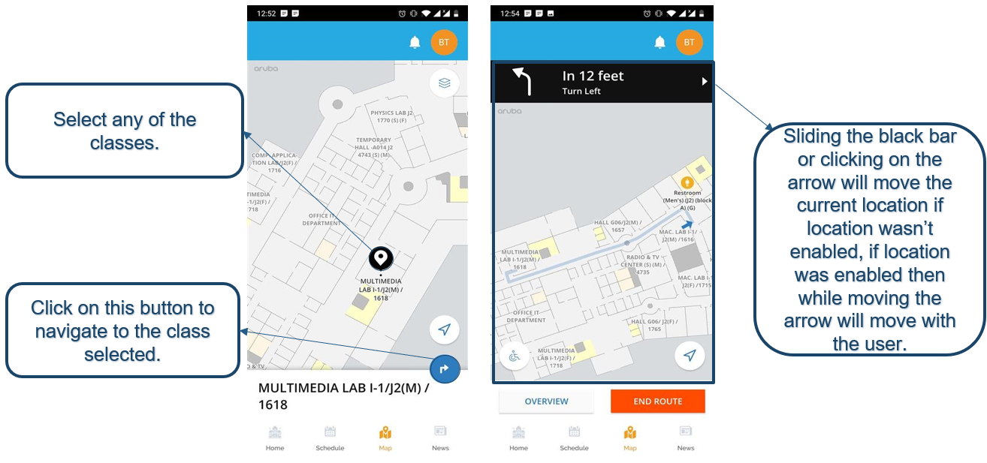

Slide 27
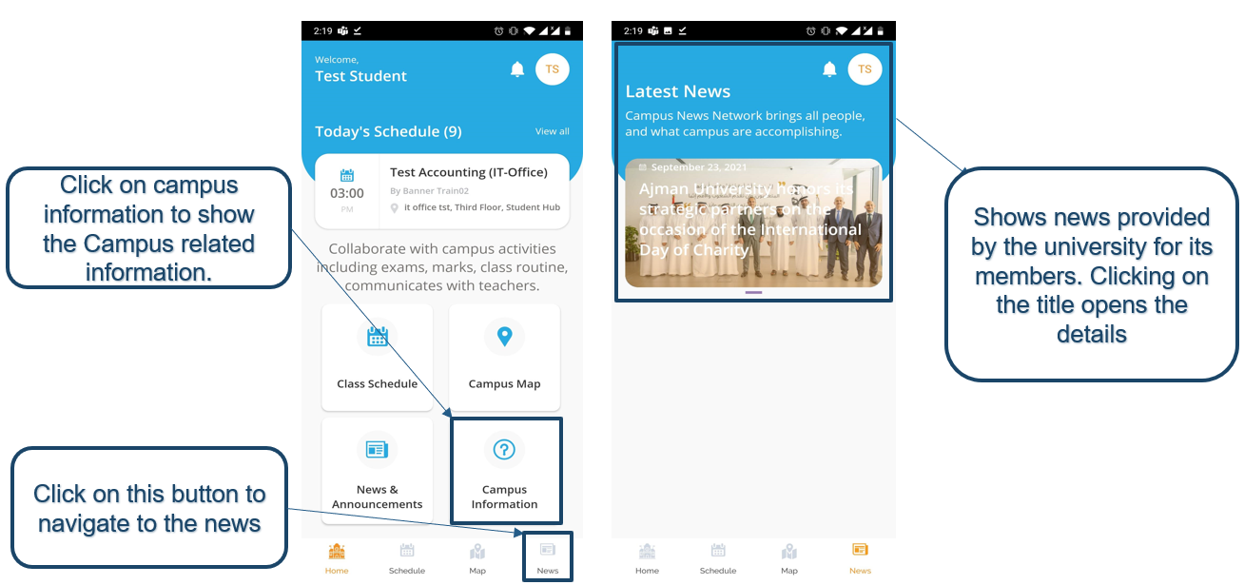
AU News

Slide 28
Learning Resources
It.ajman.ac.ae

Slide 29


Thank you for attending
Thank you for attending
If you require further assistance, please contact the Helpdesk on:
06-7056500
helpdesk@ajman.ac.ae
If you require further assistance, please contact the Helpdesk on:
06-7056500
helpdesk@ajman.ac.ae

